Slide 1
Securing the Local Area Network

Slide 2
Layer 2 Security Considerations
Upon completion of the section, you should be able to:
Describe CAM table overflow attacks.
Configure port security to mitigate CAM table overflow attacks.
Configure VLAN Truck security to mitigate VLAN hopping attacks.
Implement DHCP Snooping to mitigate DHCP attacks.
Implement Dynamic Arp Inspection to mitigate ARP attacks.
Implement IP Source Guard to mitigate address spoofing attacks.

Slide 3
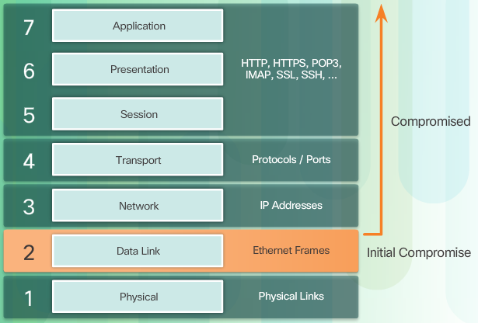
Describe Layer 2 Vulnerabilities
Notes:
6.2.1.1 Describe Layer 2 Vulnerabilities

Slide 4
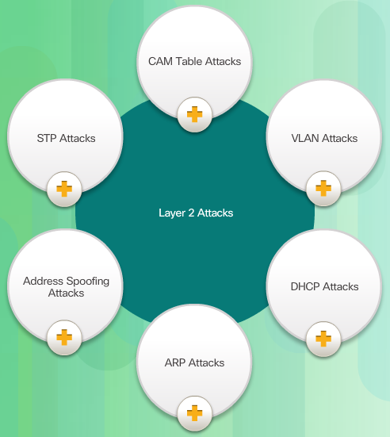
Switch Attack Categories
Notes:
6.2.1.2 Switch Attack Categories

Slide 5

Topic 1: CAM Table Attacks

Slide 6
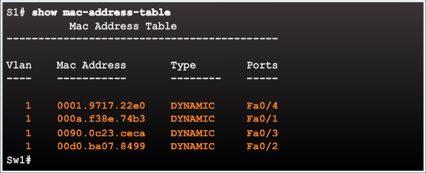
Basic Switch Operation
Notes:
6.2.2.1 Basic Switch Operation

Slide 7
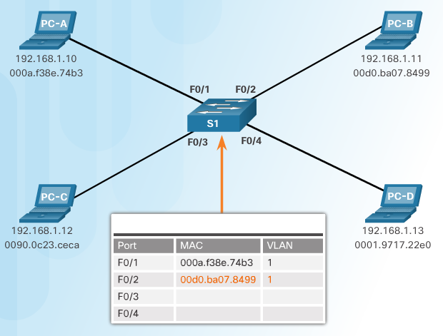
CAM Table Operation Example
Notes:
6.2.2.2 CAM Table Operation Example

Slide 8
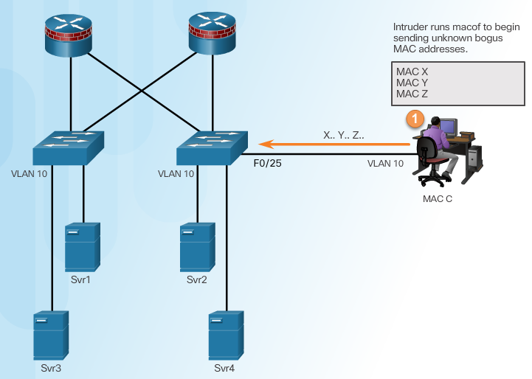
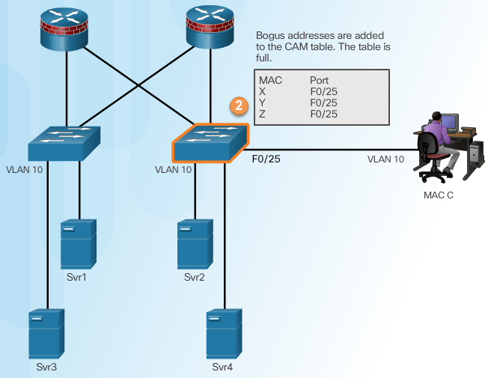
CAM Table Attack
Intruder Runs Attack Tool
Fill CAM Table
Notes:
6.2.2.3 CAM Table Attack

Slide 9
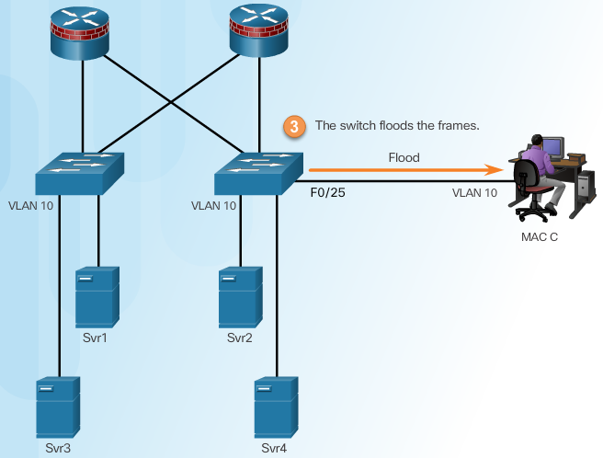
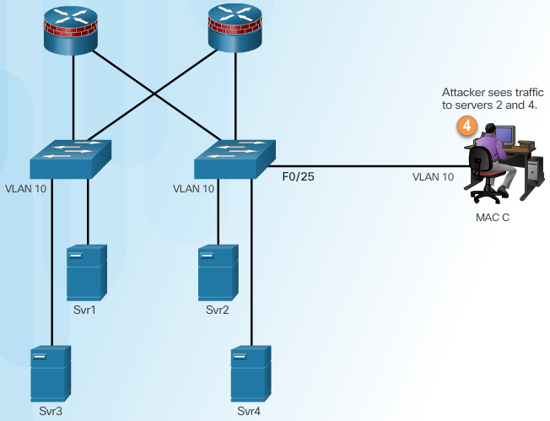
CAM Table Attack
Switch Floods All Traffic
Attacker Captures Traffic
Notes:
6.2.2.3 CAM Table Attack (Cont.)

Slide 10
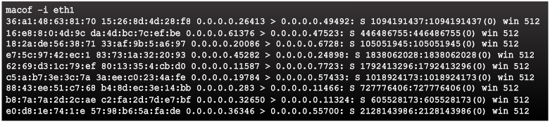
CAM Table Attack Tools
Notes:
6.2.2.4 CAM Attack Tools

Slide 11
Mitigating CAM Table Attacks

Slide 12
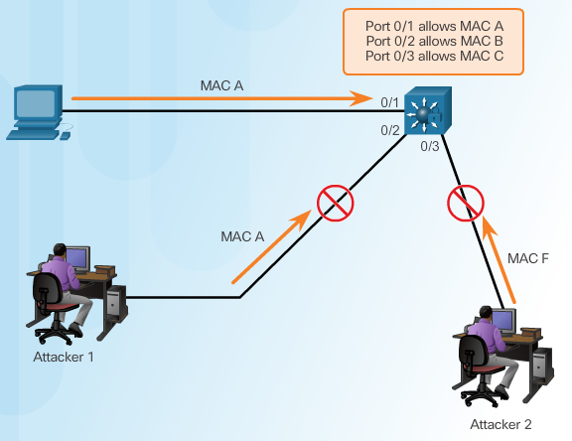
Countermeasure for CAM Table Attacks
Notes:
6.2.3.1 Countermeasure for CAM Table Attacks

Slide 13
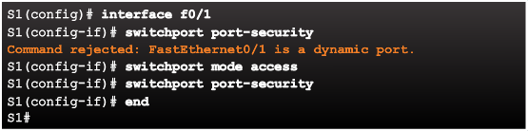
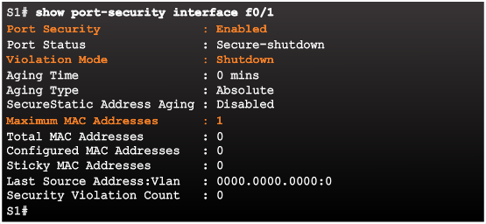
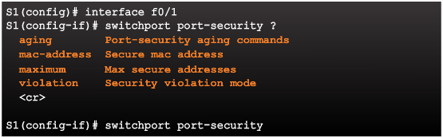
Port Security
Enabling Port Security
Verifying Port Security
Port Security Options
Notes:
6.2.3.2 Port Security

Slide 14
Enabling Port Security Options
Setting the Maximum Number of Mac Addresses
Manually Configuring Mac Addresses
Learning Connected Mac Addresses Dynamically
Notes:
6.2.3.3 Enabling Port Security Options

Slide 15
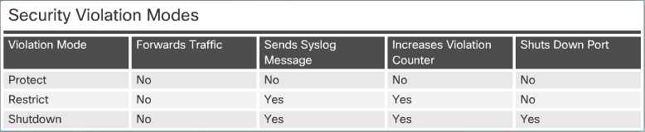
Port Security Violations
Security Violation Modes:
Protect
Restrict
Shutdown
Notes:
6.2.3.4 Port Security Violations

Slide 16
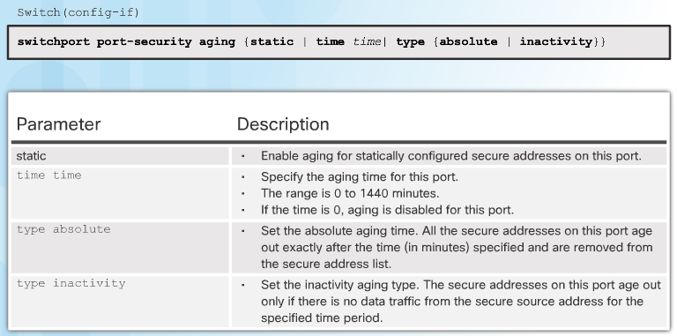
Port Security Aging
Notes:
6.2.3.5 Port Security Aging

Slide 17

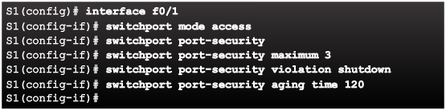
Port Security with IP Phones
Notes:
6.2.3.6 Port Security with IP Phones

Slide 18
Topic 2: Mitigating VLAN Attacks

Slide 19
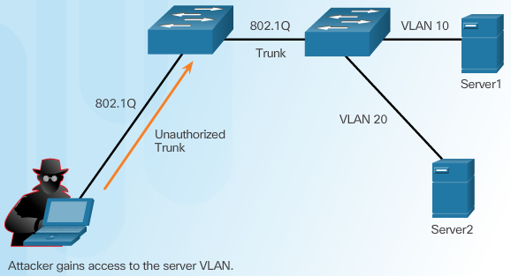
VLAN Hopping Attacks
Notes:
6.2.4.1 VLAN Hopping Attacks

Slide 20
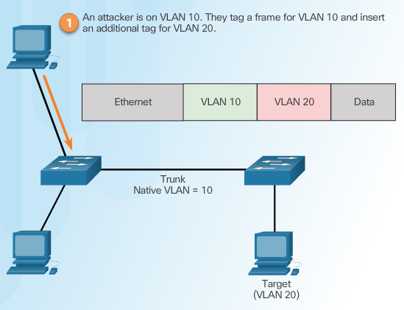
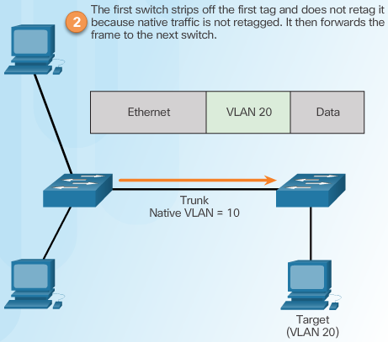
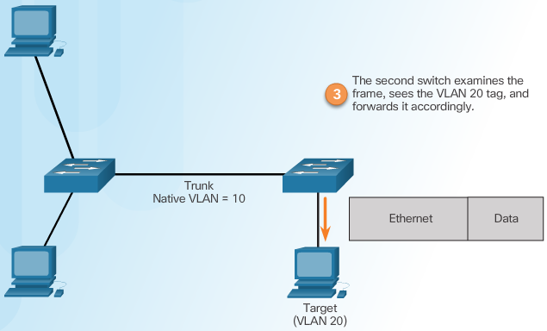
VLAN Double-Tagging Attack
Step 1 – Double Tagging Attack
Step 2 – Double Tagging Attack
Step 3 – Double Tagging Attack
Notes:
6.2.4.2 VLAN Double-Tagging Attack

Slide 21
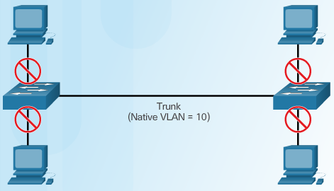
Mitigating VLAN Hopping Attacks
switch(config-if)# switchport mode access
Configure port as an access port
Notes:
6.2.4.3

Slide 22
Implementing Switch Port Analyzer
SPAN

Slide 23
Switch Port Analyzer
The Switch Port Analyzer (SPAN) feature is used to mirror traffic from one source switch port or VLAN to a destination port.
It allows a monitoring device, such as a network analyzer or “sniffer”, to be attached to the destination port for capturing traffic.
SPAN is available in two different forms:
SPAN: Both the SPAN source and destination are located on the same switch.
Remote SPAN (RSPAN): The SPAN source and destination are located on different switches. Mirrored traffic is copied over a special – purpose VLAN across trunks between switches from the source to the destination.

Slide 24
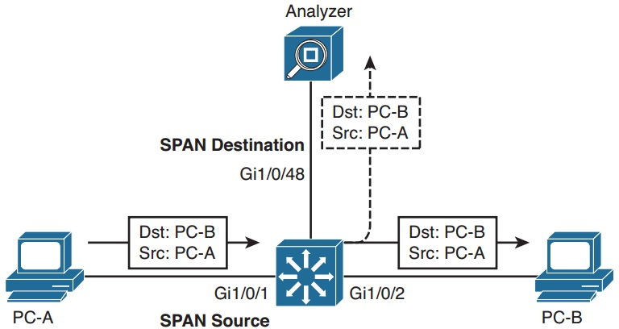
SPAN
Both the SPAN source and destination are located on the same switch.

Slide 25
SPAN Configuration
Define the source of the SPAN session data:
Switch(config)# monitor session-id source {vlan vlan-list | interface interface-number} [tx | rx | both]
session-id: Uniquely identify the SPAN session.
source interface interface-number: Specify the interface which traffic incoming or outgoing traffic will be monitored.
source vlan vlan-list: Specify the VLANs which traffic transit through will be monitored.
tx | rx | both: Traffic can be selected for mirroring based on the direction it is traveling the SPAN source (tx: transmitted from the source, rx: received from the source, both: traffic in both directions).

Slide 26
SPAN Configuration (Cont.)
Identify the SPAN destination:
Switch(config)# monitor session-id destination interface interface-number [encapsulation replicate][ingress {vlan vlan-id | dot1q vlan vlan-id | isl}]
session-id: Uniquely identify the SPAN session.
destination interface interface-number: Identify the destination interface used by the session.
encapsulation replicate: Capture any VLAN tagging information of the Layer 2 Protocol packets.
ingress vlan vlan-id: Allows sending traffic into the destination port. Sending traffic will be sent untagged to VLAN vlan-id.
ingress {dot1q vlan vlan-id | isl}: Allows sending traffic into the destination port. Sending traffic will be sent with tag dot1q or ISL. With dot1q tag, native VLAN is specified.

Slide 27
SPAN Configuration (Cont.)
Example:
SW(config)# monitor session 1 source interface g1/0/1 both
SW(config)# monitor session 1 destination interface g1/0/48
Monitoring traffic going to and coming from a device connected to the interface g1/0/1 and the network analyzer is connected to the interface g1/0/48.

Slide 28
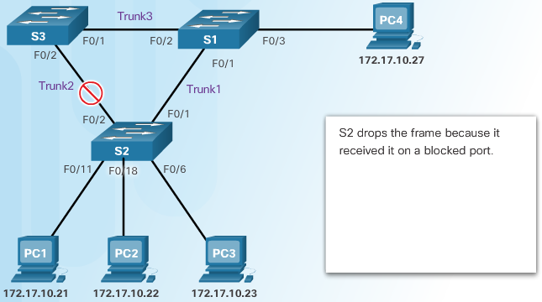
Introduction to the Spanning Tree Protocol
Notes:
6.2.8.1 Introduction to the Spanning Tree Protocol

Slide 29


Spanning Tree Manipulation
Root Bridge
F
F
F
B
F
F
F
F
STP BPDU
STP BPDU
F
B
F
F
Root Bridge

Slide 30
Implementing BPDUGuard to Mitigate Spanning Tree Manipulation
Switch(config)#spanning-tree portfast bpduguard
or
Switch(config-if)#spanning-tree bpduguard enable
The BPDU – guard feature shuts down ports when ports receive BPDU.

Slide 31
Auto recovery from err-disable state
If the BPDU – guard feature has shutdown a port, the port can be restored to an operational state using the error-disable recovery procedure.
Enable recovery cause is BPDU – guard :
Switch(config)#errdisable recovery cause bpduguard
Set a global recovery timeout by using the command:
Switch(config)#errdisable recovery interval seconds

Slide 32


phamthaikhanh@gmail.com
This Photo by Unknown Author is licensed under CC BY-NC

